Slide 1
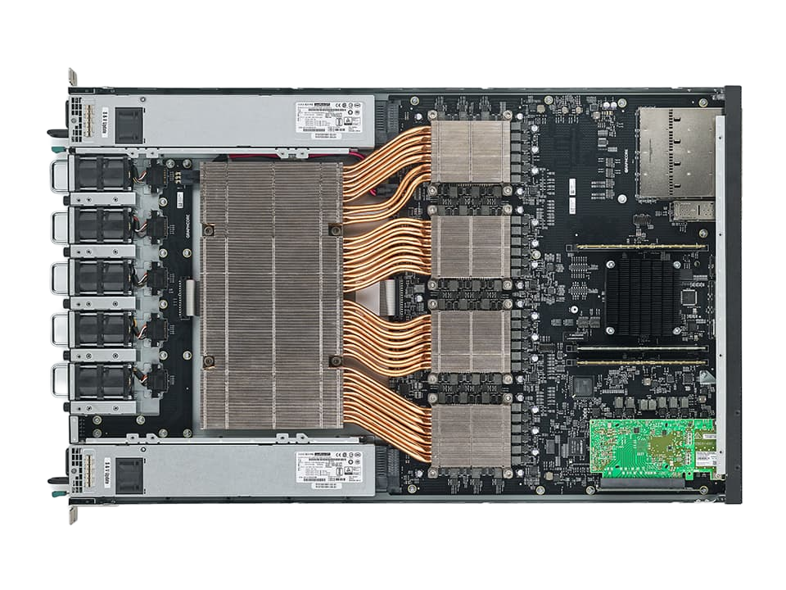

Rendering 3D Gaussians on a Graph Processor
Nicholas Fry, Ignacio Alzugaray, Mark Pupilli†, Paul H. J. Kelly, Andrew J. Davison
†Independent Researcher

Slide 2
Motivation
Humans interact with 3D space in smooth motions.

Slide 3
Motivation
Humans interact with 3D space in smooth motions.
Can we exploit the continuity of 2D projections?

Slide 4
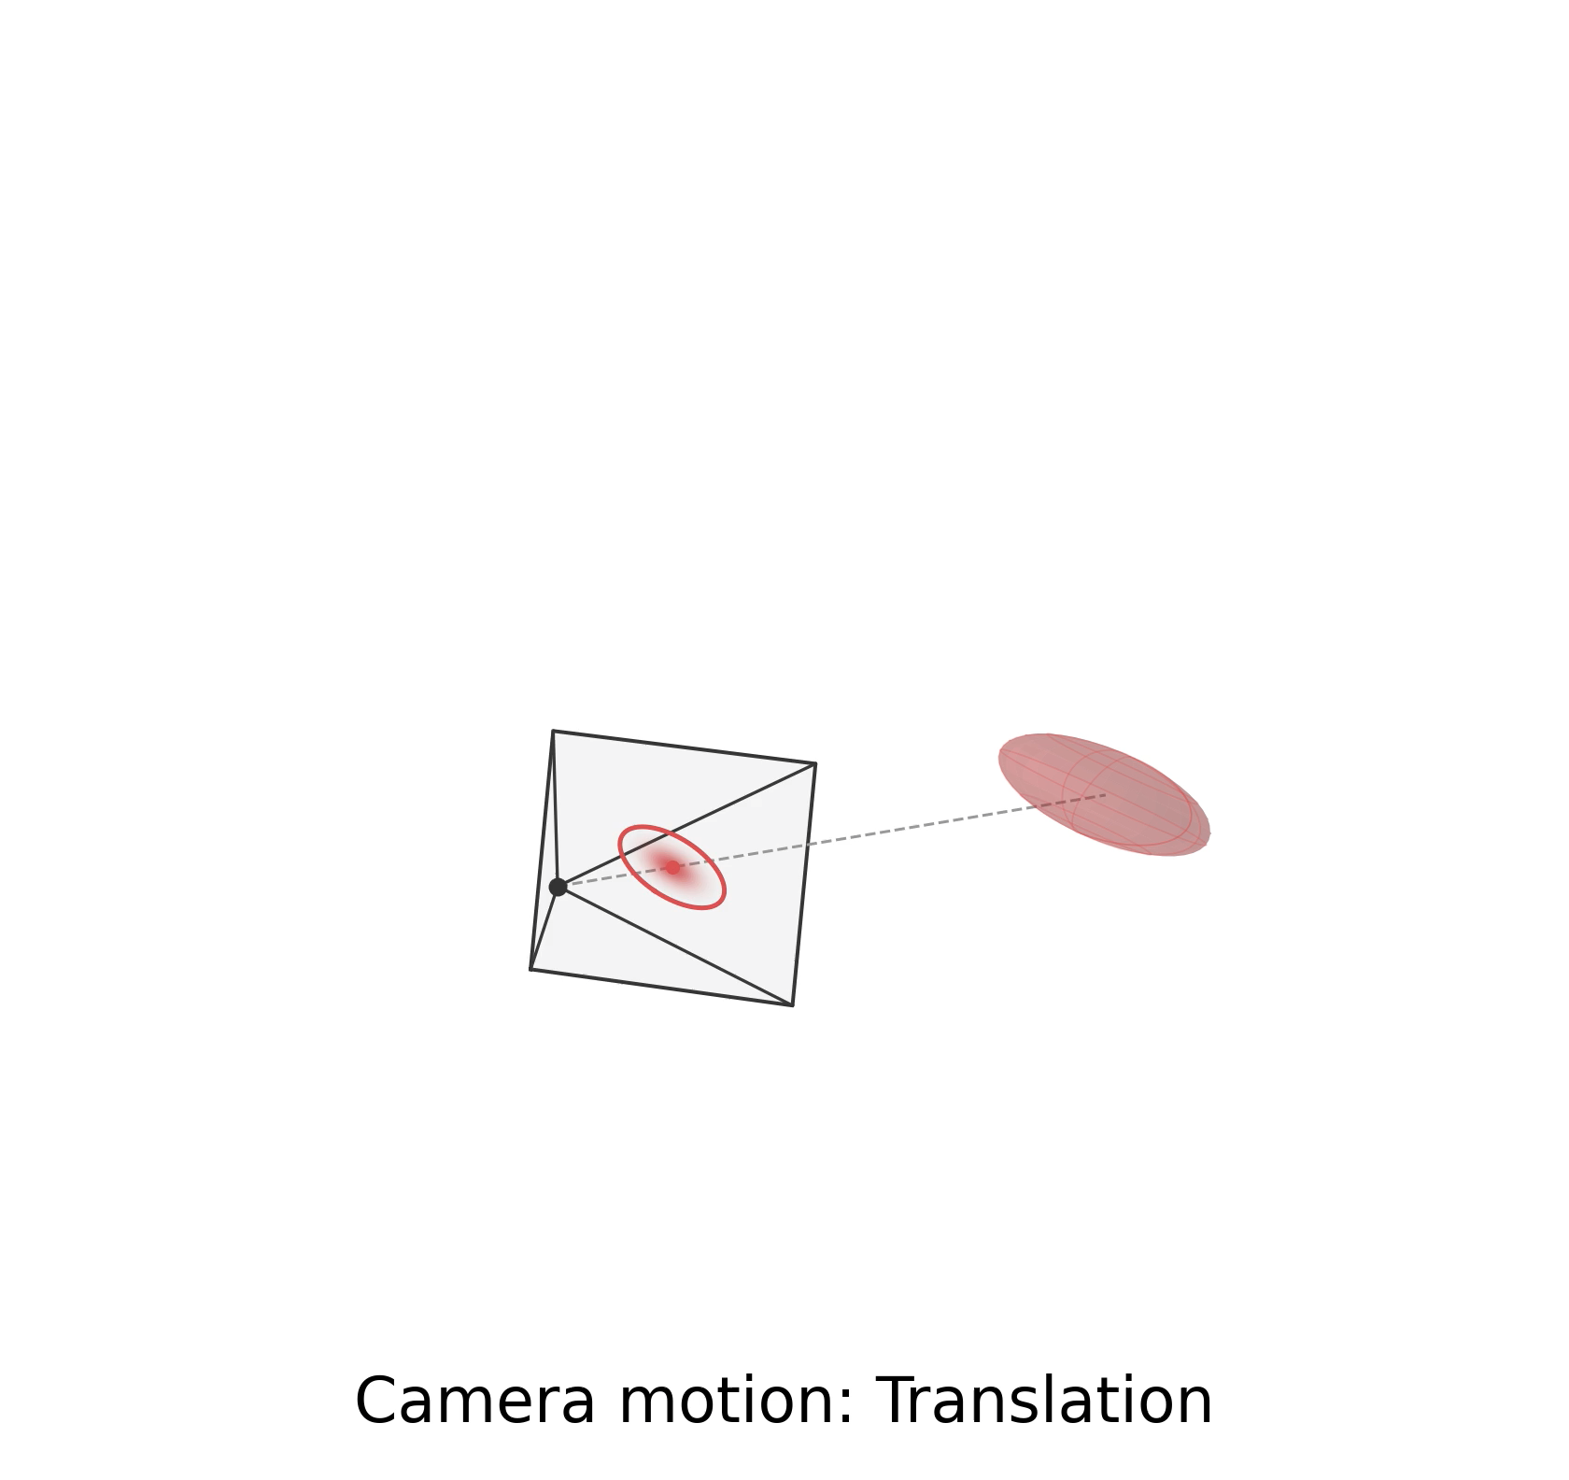
3D Gaussian Splatting

Slide 5
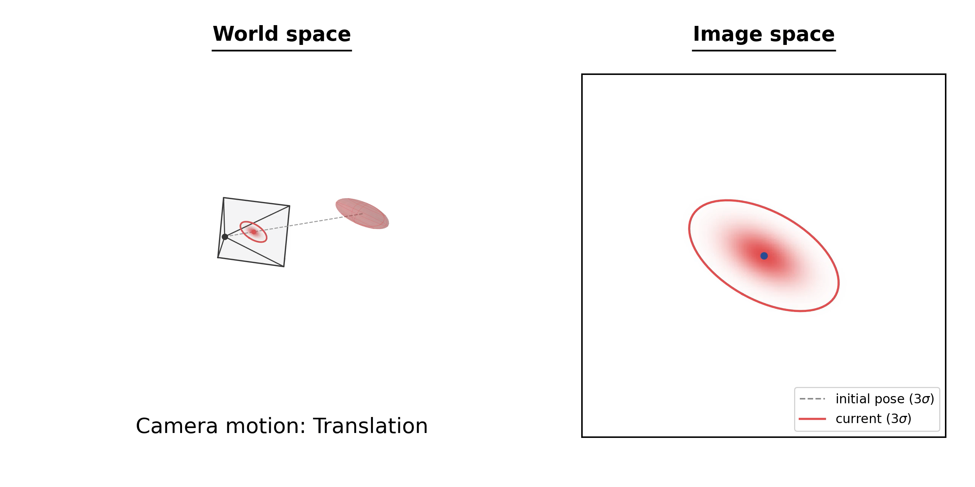
3D Gaussian Splatting
World Space
Image Space

Slide 6
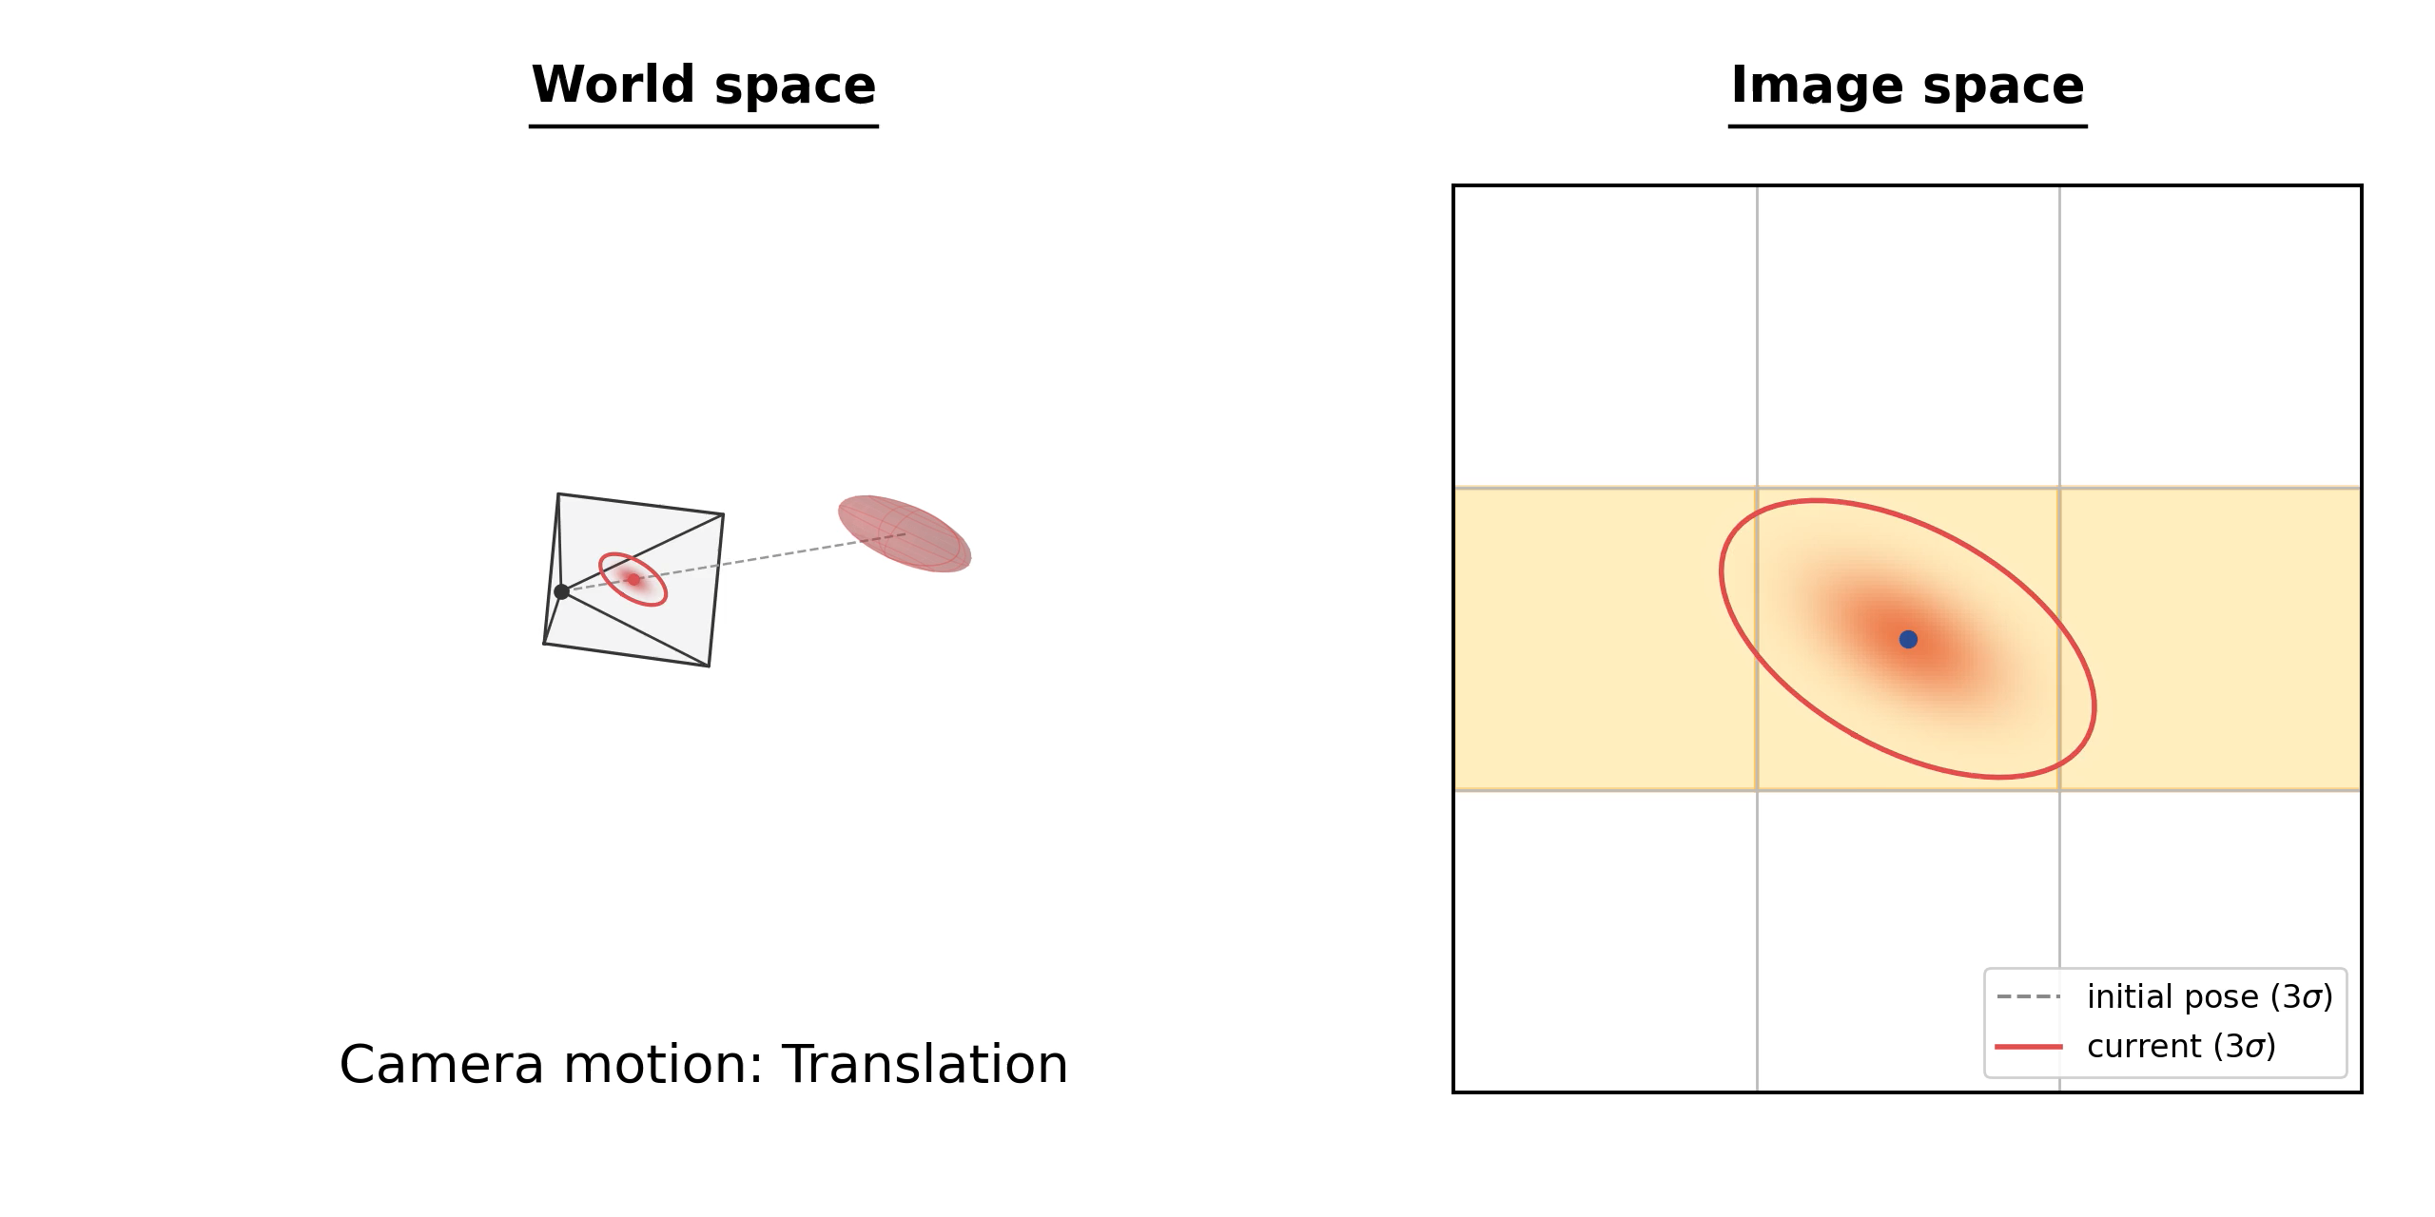
3D Gaussian Splatting
World Space
Image Space

Slide 7
Data Locality

Slide 8
Data Locality
Spatial Locality
Temporal Locality

Slide 9
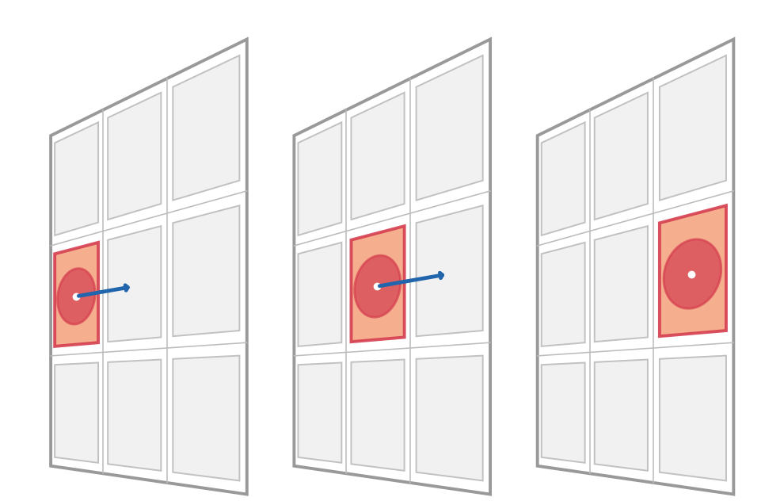
Data Locality
Spatial Locality
Temporal Locality
t
t+1
t+2
Time

Slide 10
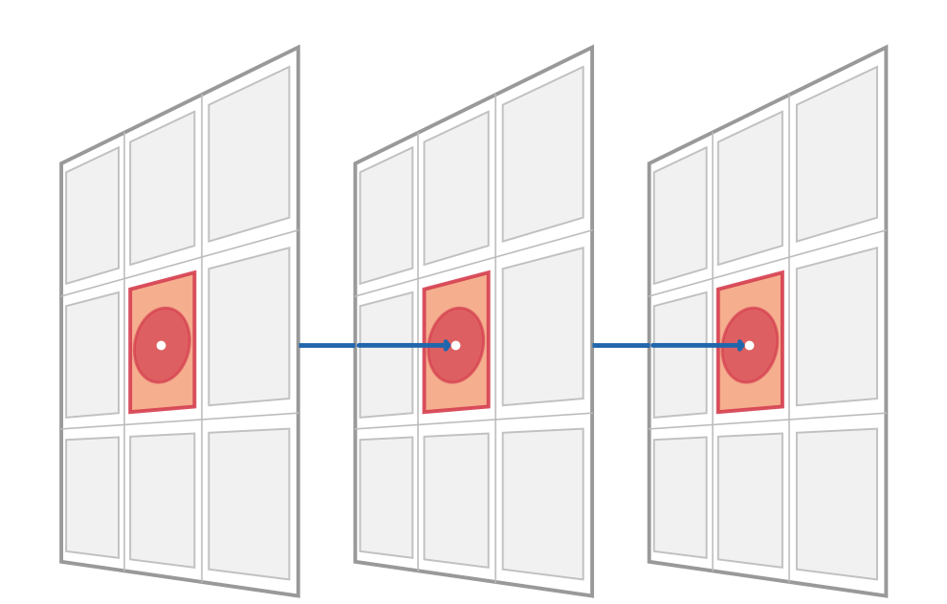
Data Locality
Spatial Locality
Temporal Locality
t
t+1
t+2
t
t+1
t+2
Time
Time

Slide 11
Data Locality
Spatial Locality
Temporal Locality
Can we exploit the
continuity of 2D projections?
t
t+1
t+2
t
t+1
t+2
Time
Time

Slide 12
Data Locality
Spatial Locality
Temporal Locality
Can we exploit the
continuity of 2D projections?
If camera doesn’t teleport
t
t+1
t+2
t
t+1
t+2
Time
Time

Slide 13
How can we exploit this?

Slide 14
Hardware with tile-tile communication.

Slide 15
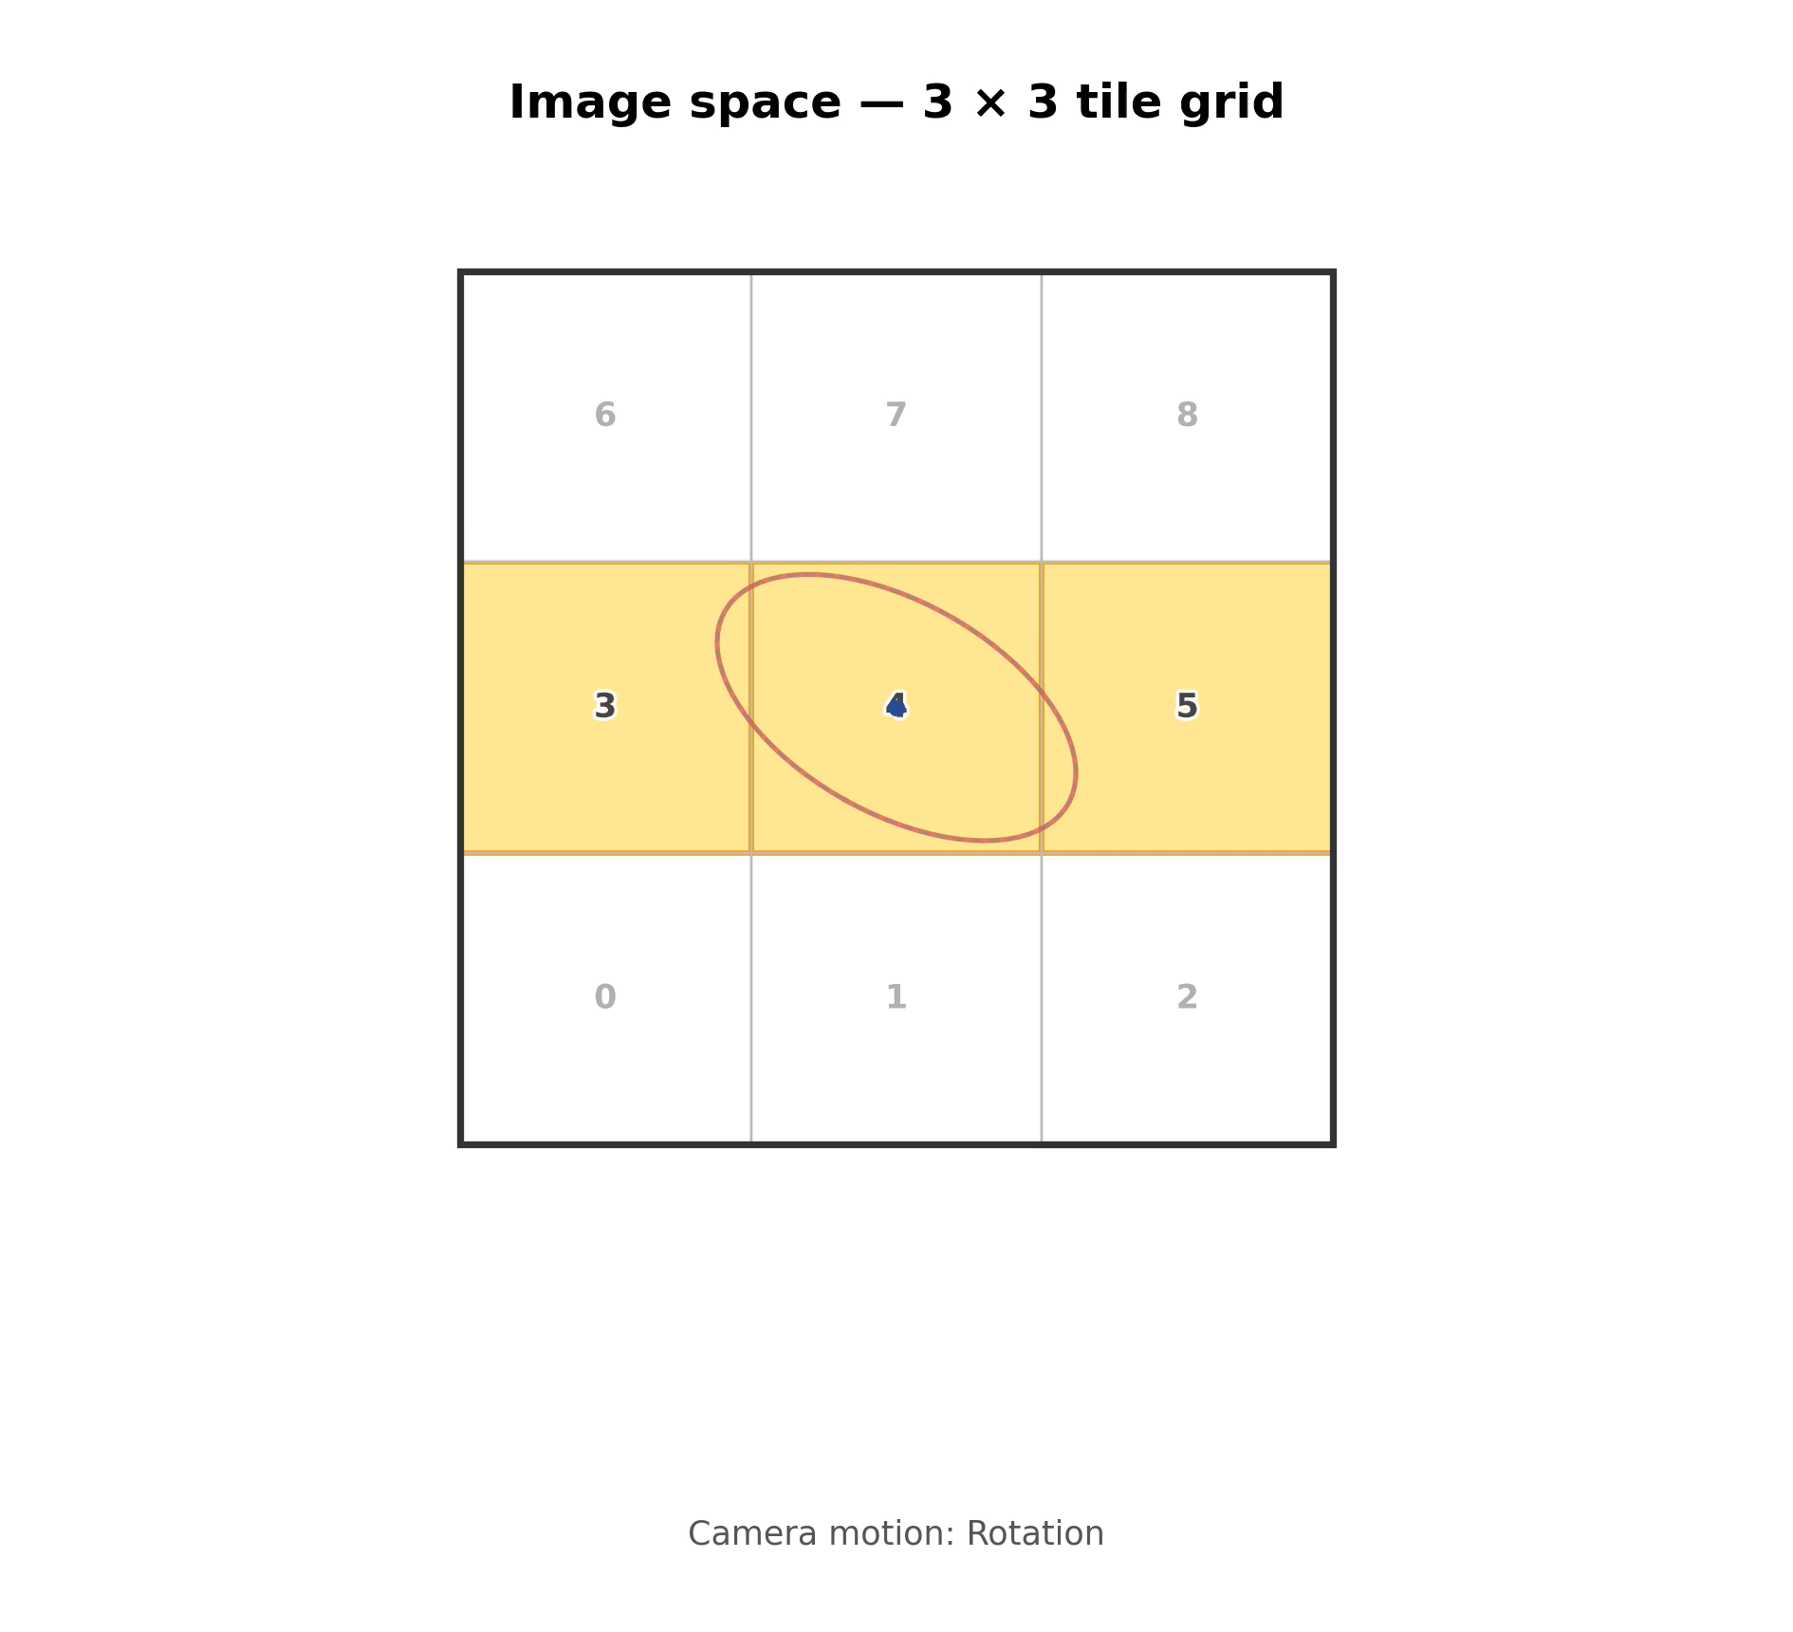

Slide 16
What architecture
supports this?

Slide 17
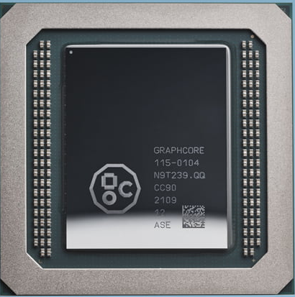
“Intelligence Processing Unit” - IPU
From: https://www.graphcore.ai/products/ipu

Slide 18
NOT an IPU sales pitch
Disclaimers
What this project is not.
NOT a claim that IPU is better for rendering than GPU (it was in no way designed for this!)

Slide 19
“Intelligence Processing Unit” - IPU
From: https://www.graphcore.ai/products/ipu

Slide 20
Intelligence Processing Unit
From: https://www.graphcore.ai/products/ipu

Slide 21
Intelligence Processing Unit
From: https://www.graphcore.ai/products/ipu

Slide 22
Intelligence Processing Unit
Tile Processor
6 hardware threads
624KiB SRAM
624 KB SRAM
Overall:
1472 Cores
8832 threads
From: https://www.graphcore.ai/products/ipu

Slide 23
Intelligence Processing Unit
Tile Processor
Advantages:
Large on-chip memory
624 KB SRAM
Highly parallel
From: https://www.graphcore.ai/products/ipu

Slide 24
Intelligence Processing Unit
Tile Processor
Advantages:
Large on-chip memory
624 KB SRAM
Highly parallel
Crossbar
All-to-All
Exchange
Constraints:
Compile time defined exchange
From: https://www.graphcore.ai/products/ipu

Slide 25
But what was wrong with
Graphics Processing Units!
>:(

Slide 26
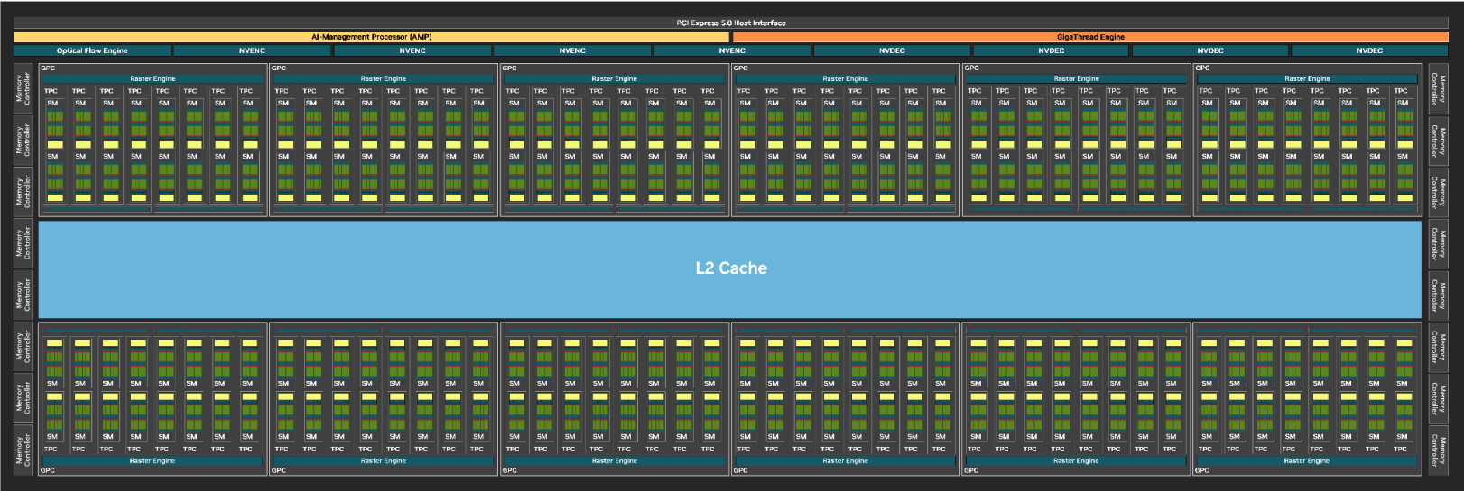
NVIDIA RTX GPU Architecture

Slide 27

NVIDIA RTX GPU Architecture

Slide 28
GPU Memory Hierarchy
Streaming Multiprocessor
SP
SP
SP
SP
SP
SP
Shared memory / L1 Cache

Slide 29
GPU Memory Hierarchy
Streaming Multiprocessor
SP
SP
SP
SP
SP
SP
Shared memory / L1 Cache

Slide 30
GPU Memory Hierarchy
Streaming Multiprocessor
SP
SP
SP
SP
SP
SP
Shared memory / L1 Cache
Statically partitioned at compile time

Slide 31
GPU Memory Hierarchy
Streaming Multiprocessor
SP
SP
SP
SP
SP
SP
Shared memory / L1 Cache
VRAM

Slide 32
GPU Memory Hierarchy
Streaming Multiprocessor
SP
SP
SP
SP
SP
SP
Shared memory / L1 Cache
L2 Cache
VRAM

Slide 33
GPU Memory Hierarchy
Streaming Multiprocessor
Streaming Multiprocessor
SP
SP
SP
…
SP
SP
SP
SP
SP
SP
x N
SP
SP
SP
Shared memory / L1 Cache
Shared memory / L1 Cache
L2 Cache
VRAM

Slide 34
GPU Memory Hierarchy
Streaming Multiprocessor
Streaming Multiprocessor
SP
SP
SP
…
SP
SP
SP
SP
SP
SP
x N
SP
SP
SP
Shared memory / L1 Cache
Shared memory / L1 Cache
L2 Cache
VRAM

Slide 35
GPU Memory Hierarchy
Streaming Multiprocessor
Streaming Multiprocessor
SP
SP
SP
…
SP
SP
SP
SP
SP
SP
x N
SP
SP
SP
Shared memory / L1 Cache
Shared memory / L1 Cache
L2 Cache
VRAM
(To move data you must PAY THE TOLL)

Slide 36
SM-SM ? “IPU-style”
Streaming Multiprocessor
Streaming Multiprocessor
SP
SP
SP
SP
SP
SP
SP
SP
SP
SP
SP
SP
Shared memory / L1 Cache
Shared memory / L1 Cache

Slide 37
SM-SM ? “IPU-style”
Streaming Multiprocessor
Streaming Multiprocessor
SP
SP
SP
SP
SP
SP
SP
SP
SP
SP
SP
SP
Shared memory / L1 Cache
Shared memory / L1 Cache

Slide 38
SM-SM ? “IPU-style”
Streaming Multiprocessor
Streaming Multiprocessor
SP
SP
SP
SP
SP
SP
SP
SP
SP
SP
SP
SP
Shared memory / L1 Cache
Shared memory / L1 Cache
Hierarchies add complexity, latency and consume energy

Slide 39
SM-SM ? “IPU-style”
Streaming Multiprocessor
Streaming Multiprocessor
SP
SP
SP
SP
SP
SP
SP
SP
SP
SP
SP
SP
Shared memory / L1 Cache
Shared memory / L1 Cache
Hierarchies add complexity, latency and consume energy

Slide 40

Reasons to try IPU
Programmable data routing
No VRAM / DRAM
Large on-chip memory
Lower power
(30 Watt vs 130 Watt 4090)
Quite parallel (MIMD – could use to load balance?)
(though not as much as GPU)

Slide 41
Back to IPU.

Slide 42
Method

Slide 43
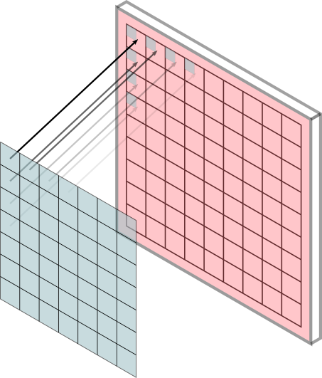
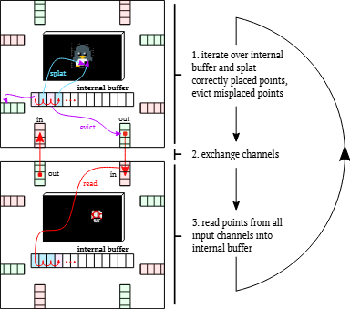
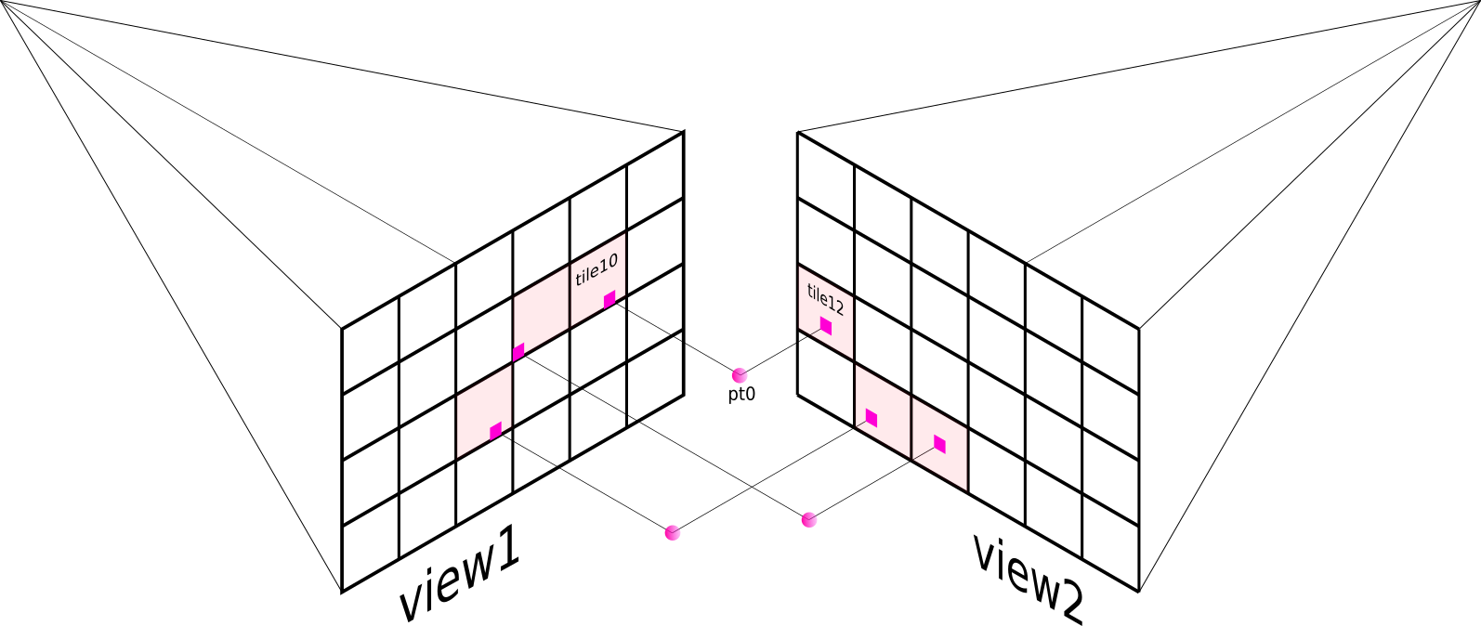
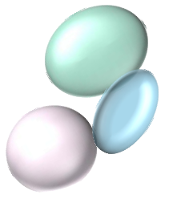
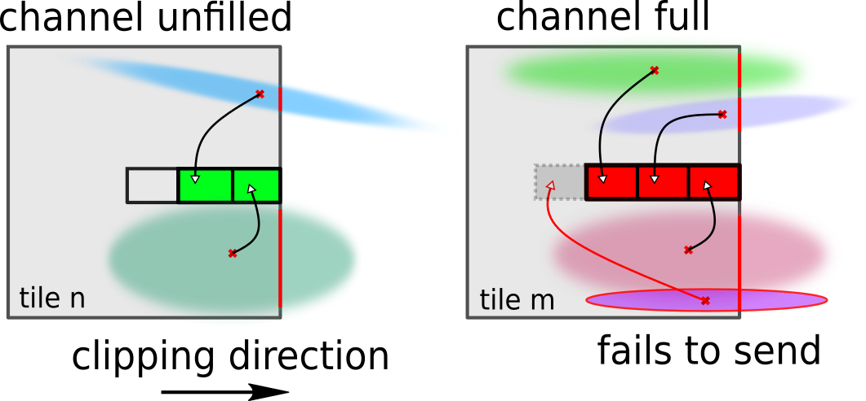
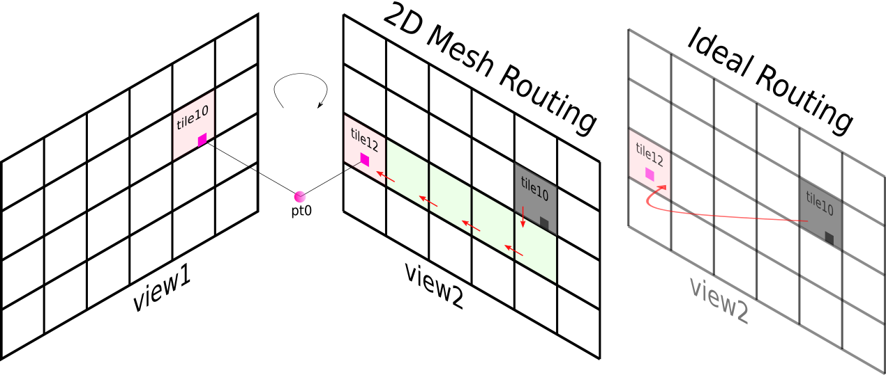
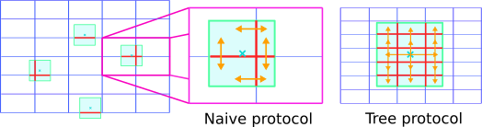
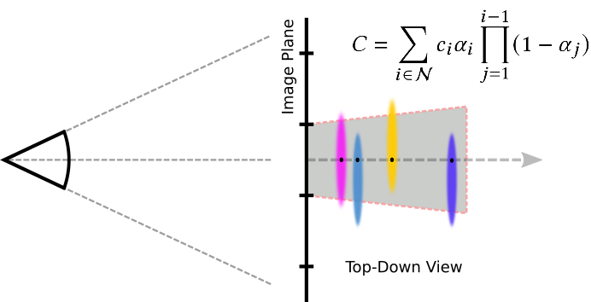
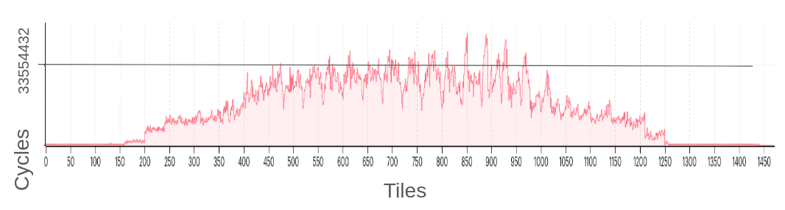

Cry in C++

Slide 44
Method
SETUP: Pin framebuffer tiles in IPU tile memory
IPU Tiles
Framebuffer Tiles

Slide 45
Method
SETUP: Allocate Gaussians to tile memory
IPU Tiles
3D Gaussians
Framebuffer Tiles

Slide 46
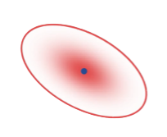

Method
1. Project and sort local Gaussians
Tile n
Tile n+1
Framebuffer
Framebuffer

Slide 47
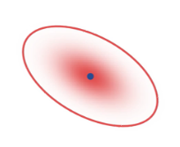
Method
2. Check if Gaussians are needed on other tiles
Tile n
Tile n+1
Framebuffer
Framebuffer

Slide 48
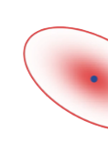
Method
2. Check if Gaussians are needed on other tiles
Tile n
Tile n+1
Framebuffer
Framebuffer

Slide 49
Method
2. Check if Gaussians are needed on other tiles
I/O
I/O

Slide 50
Method
3. Send Gaussians to neighbours
I/O
I/O

Slide 51

Method
4. Go back to step 1
I/O
I/O

Slide 52
Method
4. Go back to step 1
I/O
I/O

Slide 53
Results

Slide 54


Slide 55

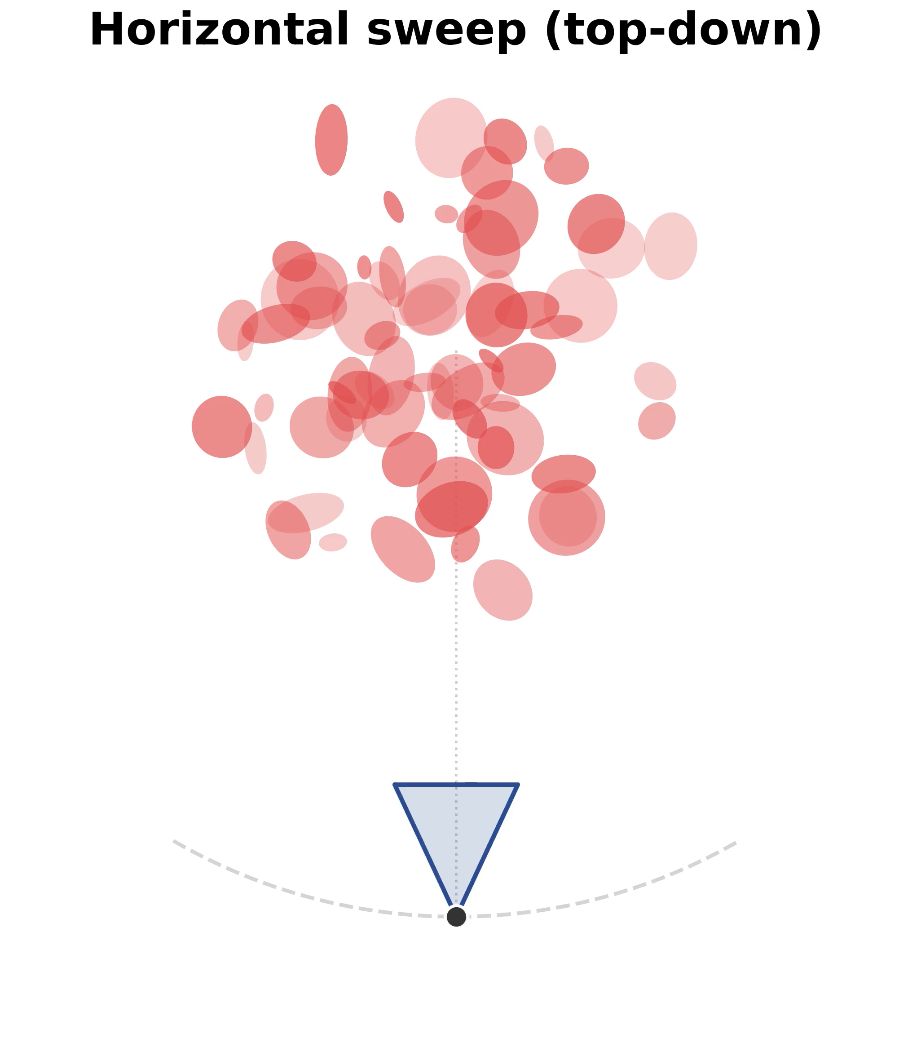
DEMO on IPU

Slide 56
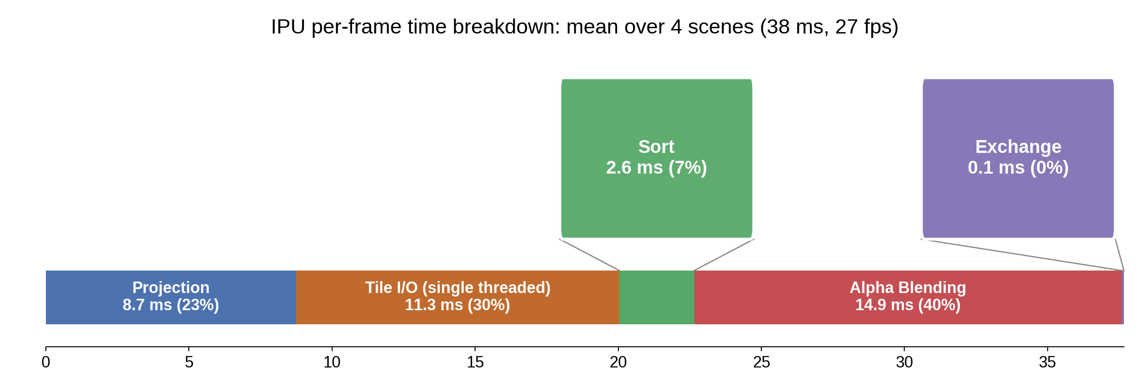
Results
IPU per frame timing breakdown: mean over 4 scenes (38ms, 27FPS)
0
5
10
15
20
25
30
35
Per frame time (ms)

Slide 57
Churn Rate
“The share of Gaussians that move in memory between frames”

Slide 58
Churn Rate
“The share of Gaussians that move in memory between frames”
t
t+1
t+2
For a single Gaussian
Churn = 0%

Slide 59
Churn Rate
“The share of Gaussians that move in memory between frames”
t
t+1
t+2
t
t+1
t+2
For a single Gaussian
Churn = 0%
Churn = 100%

Slide 60
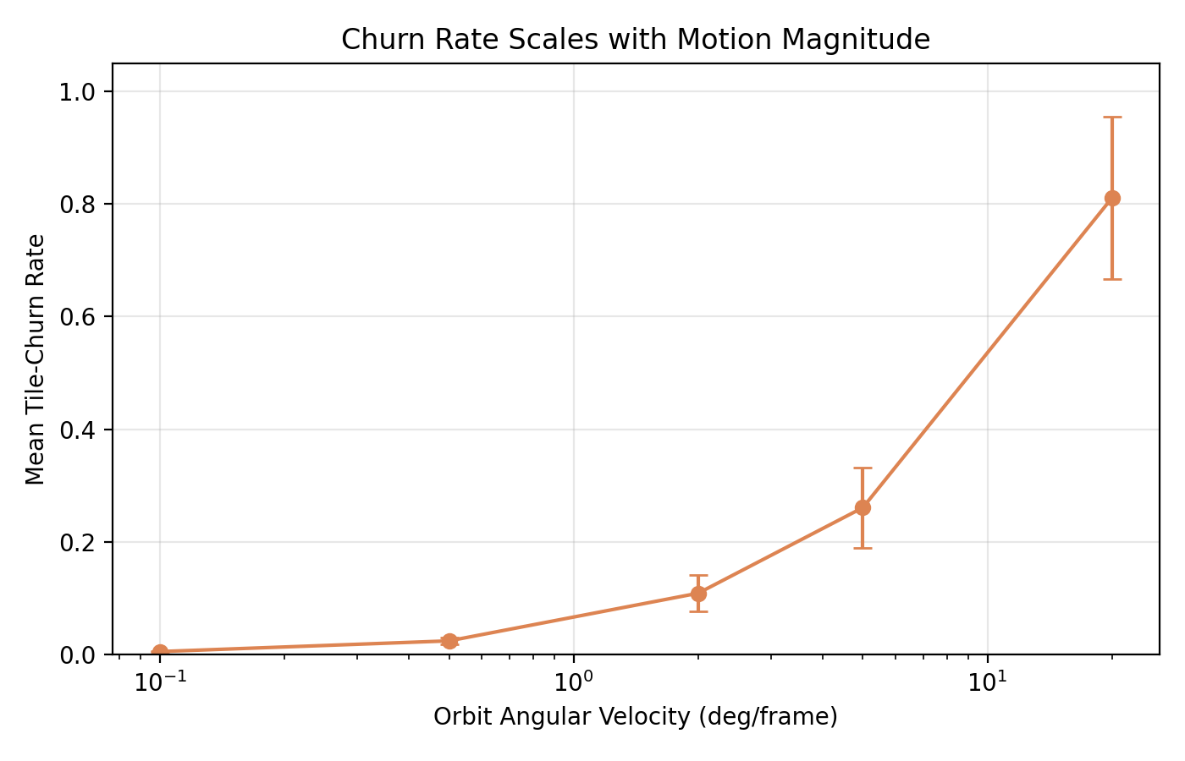
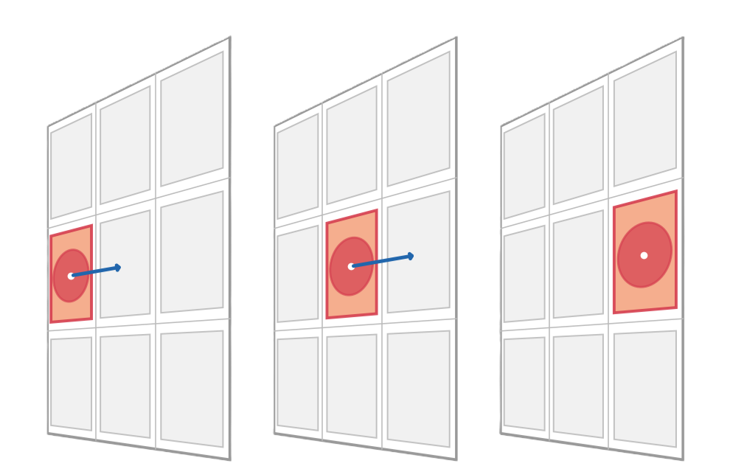
Churn Rate

Slide 61
IPU churn rate

Slide 62
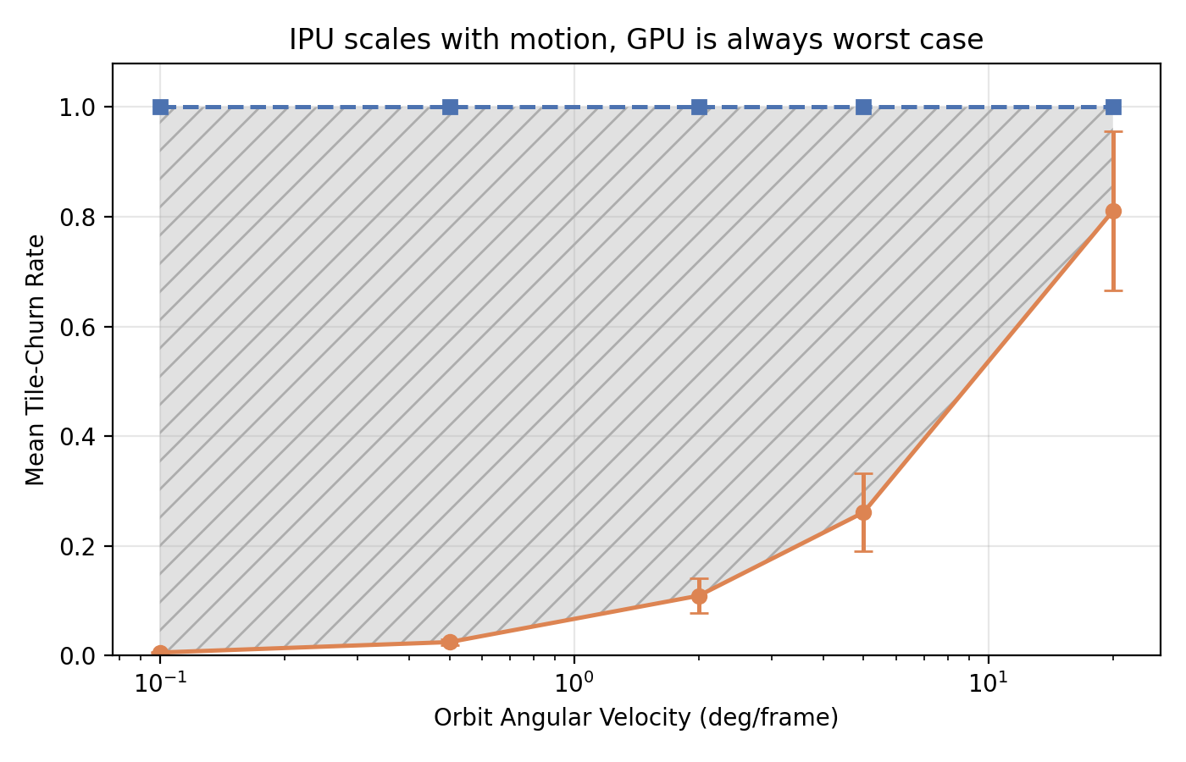
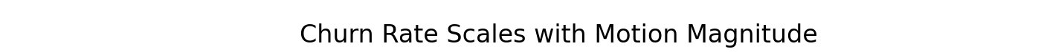
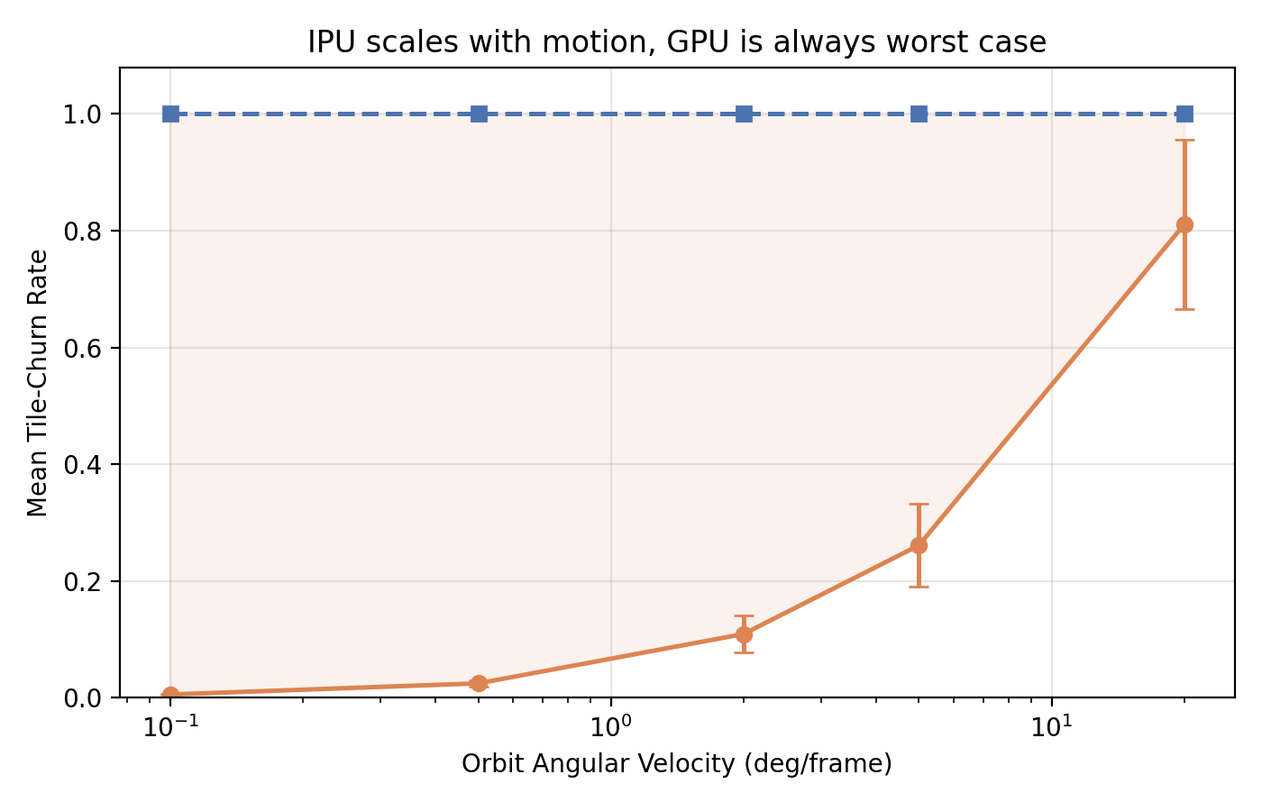
GPU churn rate
GPU churn rate
Work avoided by locality
Work avoided by data locality
IPU churn rate
IPU churn rate

Slide 63
GPU churn rate
Work avoided by data locality
Smooth motions exploit data locality
IPU churn rate

Slide 64
GPU churn rate
Work avoided by data locality
Smooth motions exploit data locality
(i.e. not much data moves here)
IPU churn rate

Slide 65
Future Work
Use IPU tile matrix engine, use all threads, optimise sorting etc.
Try backwards pass?
(hard… reductions across tiles)
Try different 3D representations
(are primitives optimally distributed?)
Try SM-to-SM feature in 5090 NVIDIA GPU? (DSMEM!)

Slide 66
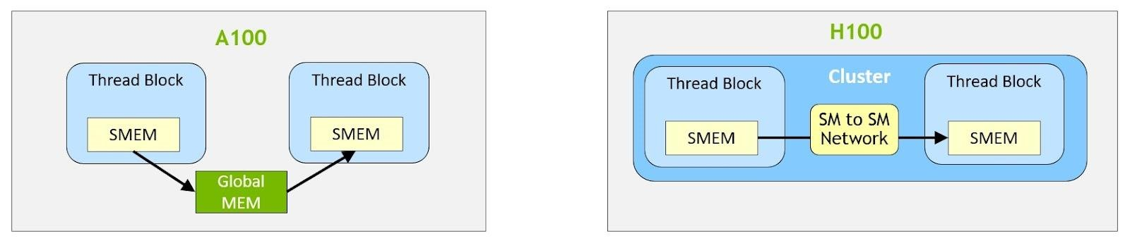
Future Work
Try SM-to-SM feature in 5090 NVIDIA GPU? (DSMEM!)
https://developer.nvidia.com/blog/nvidia-hopper-architecture-in-depth/
Distributed shared memory

Slide 67
Key Takeaways
Most of the time we interact with 3D in smooth motions
(not always, but for robotics, AR glasses, etc.)
Data complexity is AS important as computational complexity
Efficient hardware and algorithms exploit data locality

Slide 68
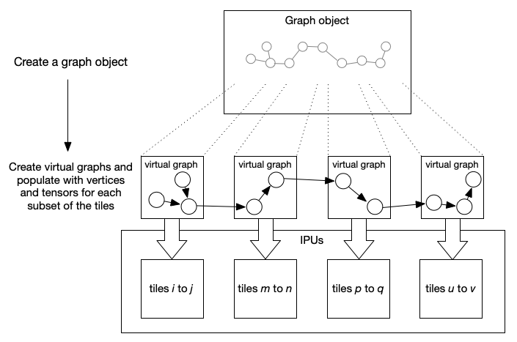

Slide 69
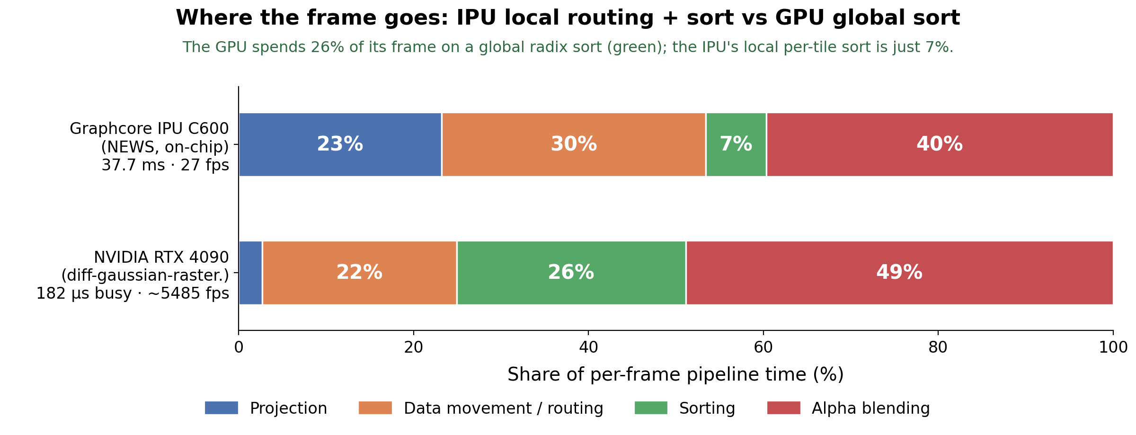

Slide 70
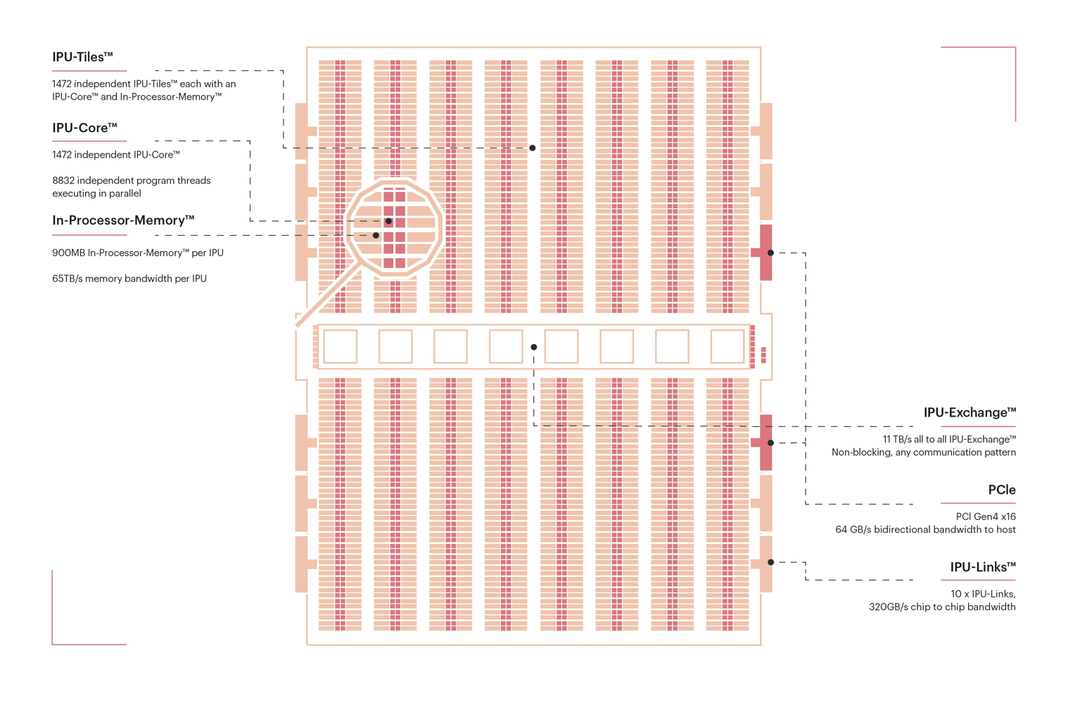

Slide 71
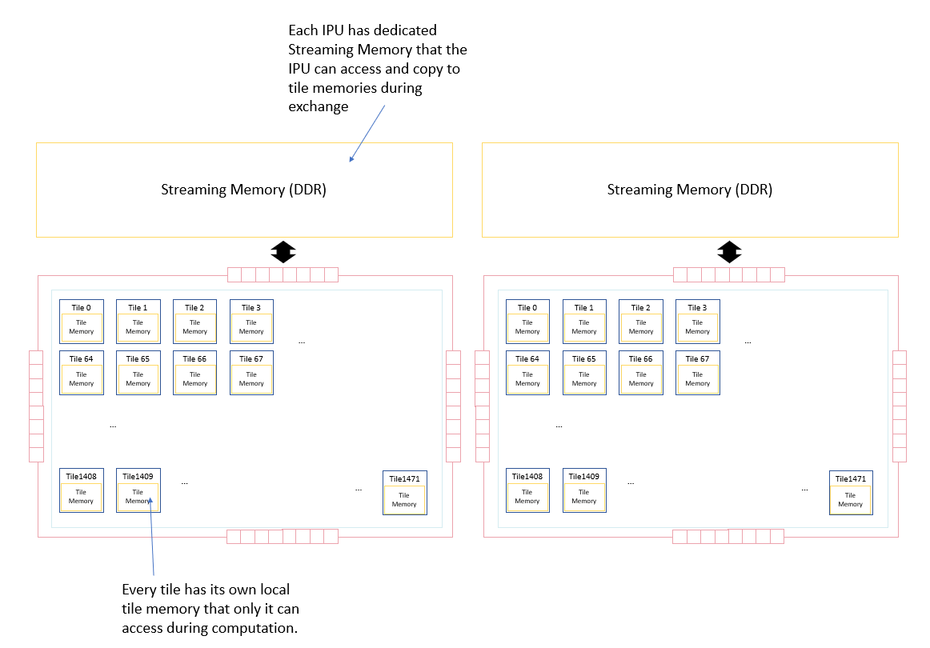

Slide 72
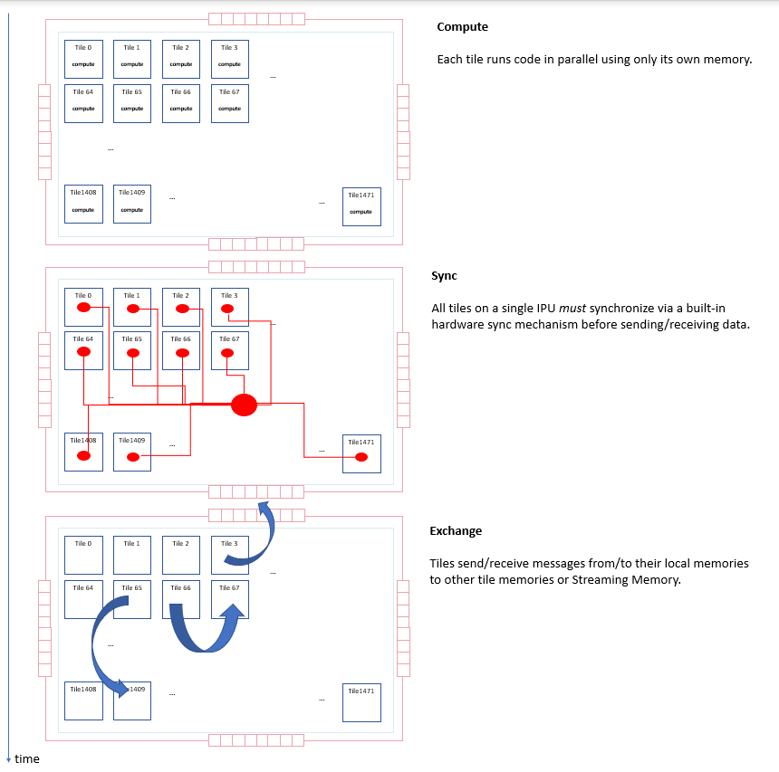

Slide 73
Current Limitations

Slide 74
Limitations

Slide 75
Limitations

Slide 76
Limitations

Slide 77
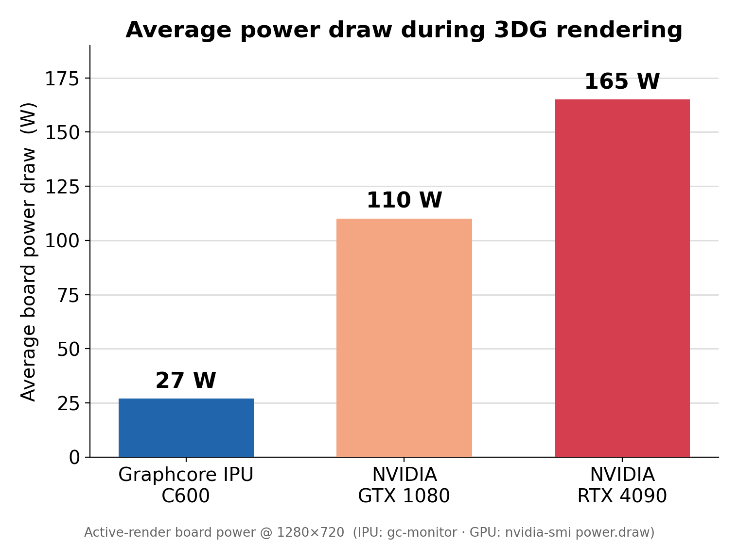
YAY!
Power
Fps
Fps per watt…

